Slide 1
Learn your lights types of light
gcse
View in slide show

Slide 2
Before you can answer questions about lighting, you first have to learn the types of light

Slide 3
Types of light
In this section you will learn about:
Wash lights
Spotlights
Side lighting
Cyc floods

Slide 4
Wash lights
Wash lights shine from above
The lens causes the light to scatter across the stage floor
This image shows an orange wash light

Slide 5
Spot lights
Spot lights are usually shone from above
The lens creates a focused beam of light
A spot light often creates a circular pool of light
This image shows a white spot light

Slide 6
Side lighting
Side lighting is shone from the side of a stage
A side light often creates a beam/shaft across the stage
This image shows two white side lights shining from the corners

Slide 7
Cyc floods
Cyc floods light a cyclorama (cyc) at the back of the stage
Cyc floods are there to set a background colour
This image shows red cyc floods

Slide 8
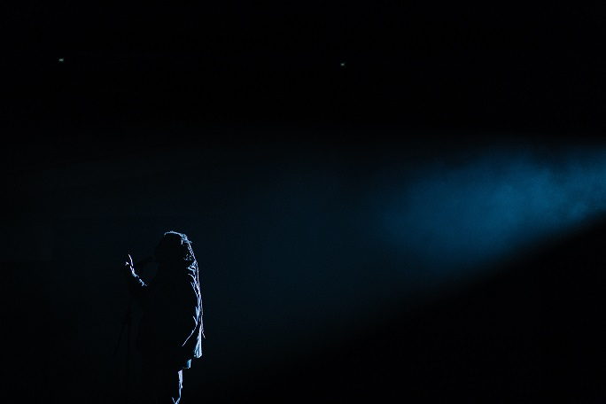
Test your knowledge!
What type of light is this?
Side light

Slide 9
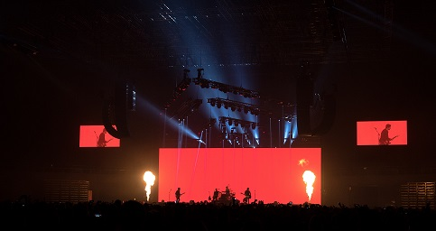
Test your knowledge!
What type of light is this?
Cyc flood

Slide 10
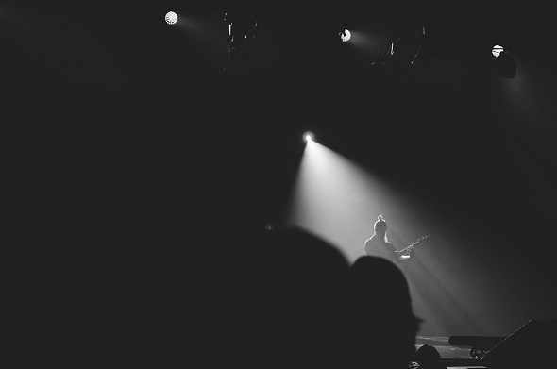
Test your knowledge!
What type of light is this?
Spot light

Slide 11
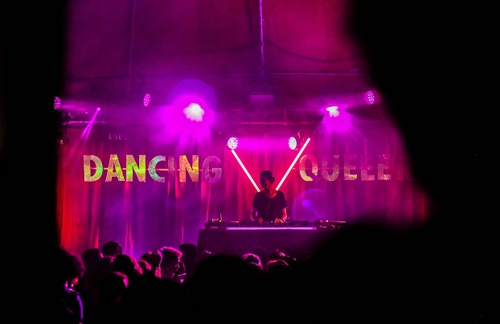
Test your knowledge!
What type of light is this?
Wash light

Slide 12
Congratulations! You have completed learn your lights : types of lights.
If you found this helpful check out
Learn your lights
Effects of light

